Slide 1


Super-Store Sales Analysis
Data Analyst Track (group B)
Team Members:
Ramy Safwat
Magid Atef
Moustafa Gaber
Mohamed Abdel Aziz
Aya Mamdouh
Abdel Halim Mahmoud

Slide 2
Agenda
Phase 2: Analysis Questions Phase
Phase 3 Forecasting Questions Phase
Phase 4:
Data Visualization
Phase 1:Build Data Model, Data Cleaning and Preprocessing

Slide 3
Phase 1:Build Data Model, Data Cleaning and Preprocessing
Problem definition
Objective Setting
Scope of Analysis
Deliverables
Benefits
Identify Entities and Attributes
Schema Designs
Data Model & Relationship Establishment
Cleaning and Preprocessing Data

Slide 4
Problem Definition & Objective
Problem definition:
In the fast-paced e-commerce landscape, grasping customer behavior and sales trends is crucial for success. Facing increasing demands and fierce competition, a major Superstore seeks our expertise to determine what strategies work best for them.
Objective:
To analyze sales data to identify Key customer segments, Regions, Categories, Products and uncover insights that can optimize sales and profitability.

Slide 5
Scope of analysis
Scope:
Sales Patterns
Regions
Categories
Product Performance.
Customer Segments

Slide 6
Deliverables
Includes:
Detailed analysis of sales data, including visualizations and key findings.
Identification of customer segments and their preferences as well as other key parameters
Actionable recommendations to refine sales strategies and drive business growth.
Development of a regression model to predict sales or profit.

Slide 7
Benefits
Includes:
Improved understanding of customer behavior and preferences.
Optimized product offerings and marketing campaigns.
Increased sales and profitability.
Enhanced decision-making capabilities

Slide 8
Identify Entities and Attributes
Includes
Customers : we have 793 customers
Segments : There are three segments Consumer ,Corporate , Home office
Cities : there are 531 Cities
States: 49 States
Regions: There are 4 regions Central, East, West, and South
Categories: There are three categories Furniture , Office Supplies, and Technology
Sub-Categories: There are 17 sub-categories
Products: there are 1850 products

Slide 9
Schema Designs
Data will be divided into 4 tables according to pillars of Analysis into :
Sales table
Customer table
Regions Table
Products Table

Slide 10
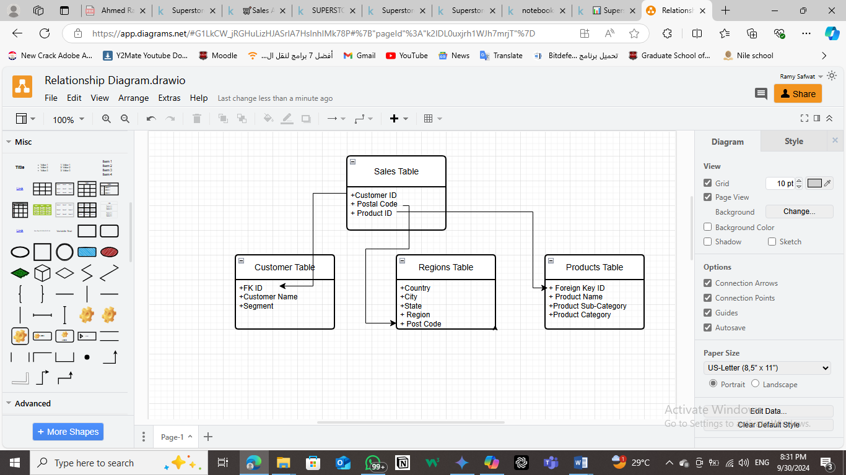
Data Model & Relationship Establishment

Slide 11
A. Python-Based Cleaning and Preprocessing (pandas)
Load Data

Slide 12
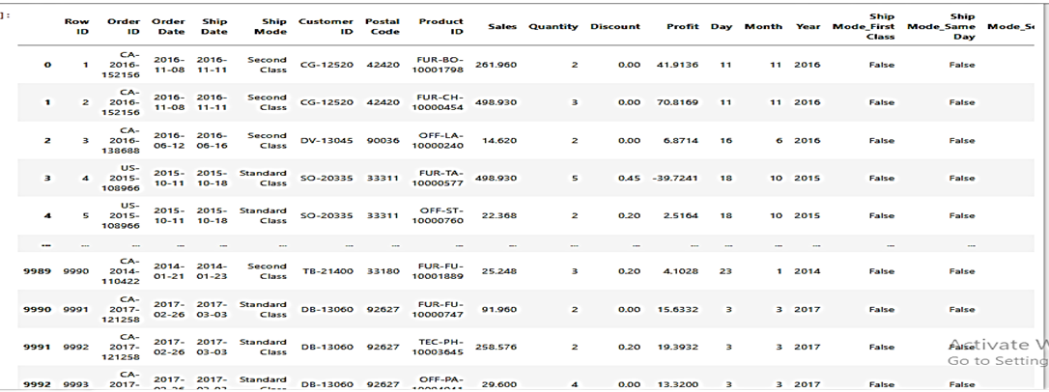
A. Python-Based Cleaning and Preprocessing (pandas)
Explore and Understand Data Via Jupyter
•from AutoClean import AutoClean
•import pandas as pd
•df=pd.read_csv("sales.csv")
•pipline=AutoClean(df)
[AutoClean process completed in 6.269056 seconds Logfile saved to: C:\Users\ramys\autoclean.log]
•pipline.output

Slide 13
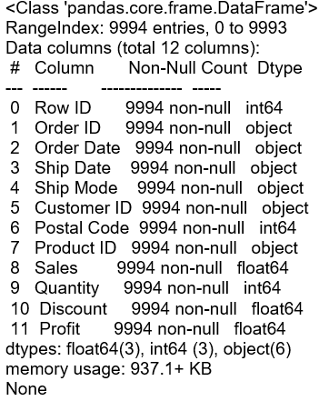
A. Python-Based Cleaning and Preprocessing (pandas)
•display(df.info())

Slide 14
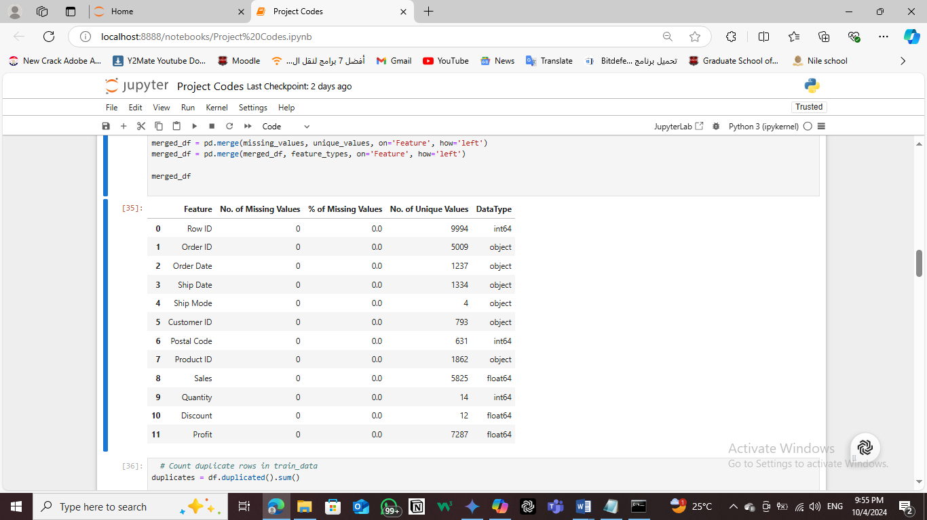
A. Python-Based Cleaning and Preprocessing (pandas)
Handling Missing Values
missing_values = pd.DataFrame({'Feature': df.columns,
'No. of Missing Values': df.isnull().sum().values,
'% of Missing Values': ((df.isnull().sum().values)/len(df)*100)})
unique_values = pd.DataFrame({'Feature': df.columns,
'No. of Unique Values': df.nunique().values})
feature_types = pd.DataFrame({'Feature': df.columns,
'DataType': df.dtypes})
merged_df = pd.merge(missing_values, unique_values, on='Feature', how='left')
merged_df = pd.merge(merged_df, feature_types, on='Feature', how='left')
merged_df

Slide 15
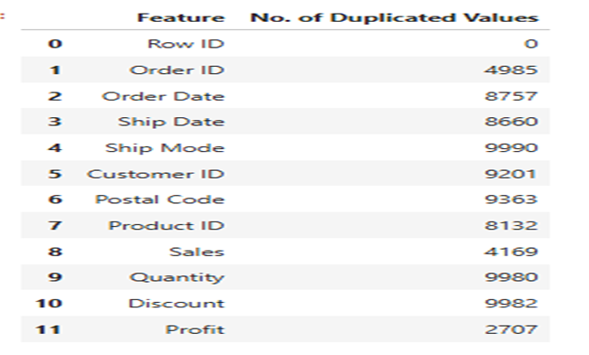
A. Python-Based Cleaning and Preprocessing (pandas)
Handling Duplicated Values
Count duplicate rows
duplicates = df.duplicated().sum()
# Print the results
print(f"Number of duplicate rows : {duplicates}")
Number of duplicate rows: 0
----------------------------------------------------------------------------------
Count duplicate values in columns
duplicated_counts = df.apply(lambda x: x.duplicated().sum())
# Create a DataFrame to display the results
duplicated_values = pd.DataFrame({
'Feature': df.columns,
'No. of Duplicated Values': duplicated_counts.values
})
duplicated_values

Slide 16
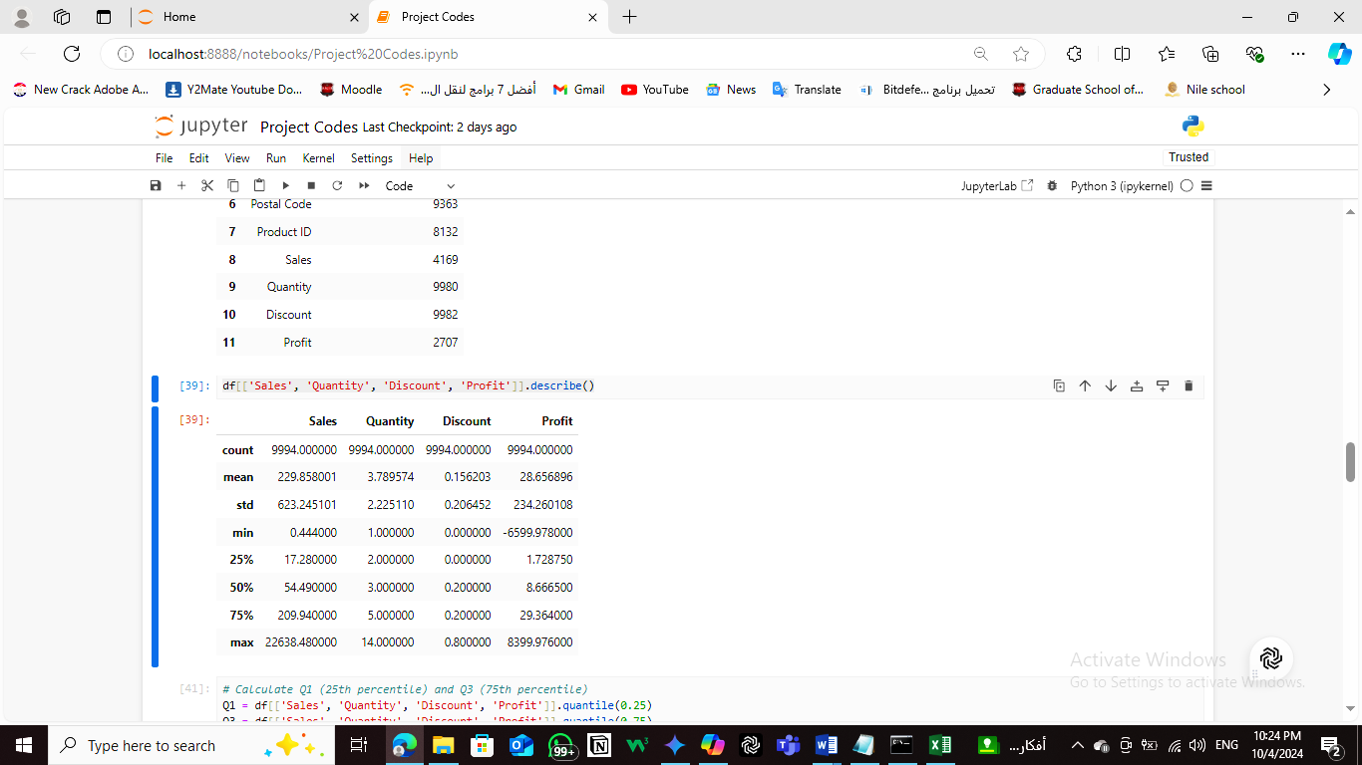
A. Python-Based Cleaning and Preprocessing (pandas)
Describing Data
df[['Sales', 'Quantity', 'Discount', 'Profit']].describe()

Slide 17
A. Python-Based Cleaning and Preprocessing (pandas)
Feature Engineering:
Create new features from existing data to improve model performance.
Creating Time frame column
# Convert columns to datetime
df['Order Date'] = pd.to_datetime(df['Order Date'])
df['Ship Date'] = pd.to_datetime(df['Ship Date'])
# Calculate the time frame (difference in days)
df['Time Frame'] = (df['Ship Date'] - df['Order Date']).dt.days
df

Slide 18
A. Python-Based Cleaning and Preprocessing (pandas)
Encoding Categorical Variables(Label Encoding):
Convert categorical values to numerical values
Labeling Encoding)
# Rank the 'Ship Mode' column
df['Ship Mode Rank'] = df['Ship Mode'].rank(method='dense')
# Display the DataFrame with the new rank column
Df

Slide 19
A. Python-Based Cleaning and Preprocessing (pandas)
Save the updated DataFrame to a CSV file
df.to_csv('updated_sales.csv', index=False)
# Display a message to confirm the file has been saved
print("CSV file has been saved as 'updated_sales.csv'")

Slide 20
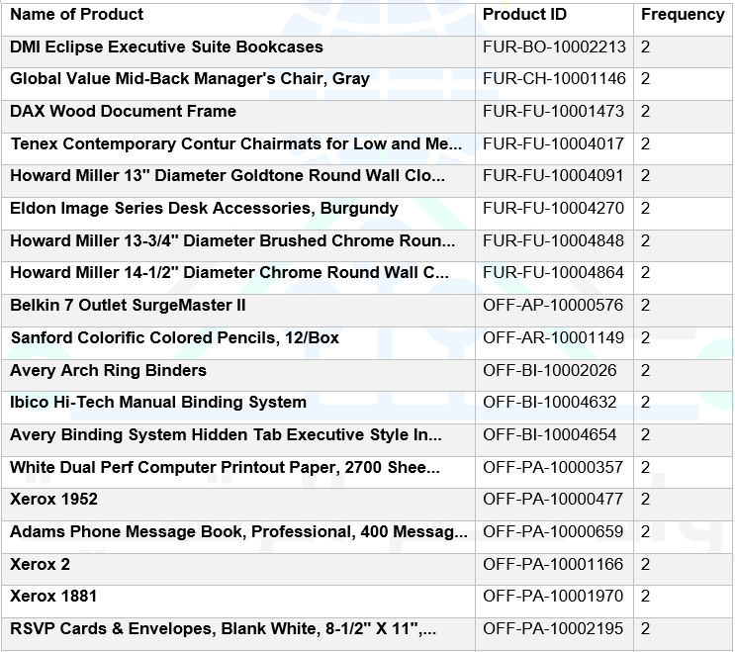
B. SQL –Based Cleaning
A. Handling Duplicated Product_ID Values in Products table
On selecting Product_ID as a primary we got the following message
MySQL said:
#1062 - Duplicate entry 'FUR-CH-10001146' for key 'PRIMARY'
SELECT Product_Name, Product_ID, COUNT(*) FROM products GROUP BY Product_ID HAVING COUNT(*) > 1 ORDER BY `products`.`Product_ID` ASC;

Slide 21
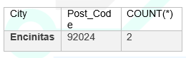
B. SQL –Based Cleaning
B. Handling Duplicated Post_Code Values in Regions table
SELECT City, Post_Code, COUNT(*)
FROM regions
GROUP BY Post_Code
HAVING COUNT(*) > 1;

Slide 22
B. SQL –Based Cleaning
Joining Tables
CREATE TABLE final_table AS
SELECT *
FROM sales_updated_sales_1 AS s
INNER JOIN products AS p ON s.Product_ID = p.ID
INNER JOIN regions AS r ON s.Postal_Code = r.Post_Code
INNER JOIN customers AS c ON s.Customer_ID = c.Cs_ID;
Adding Price columns
ALTER TABLE final_table
ADD COLUMN item_price DECIMAL(10, 2);
UPDATE sales_data
SET item_price = sales / (Quantity * (1 - Discount))
WHERE Quantity > 0 AND (1 - Discount) > 0;

Slide 23
B. SQL –Based Cleaning
Adding Quarter columns
ALTER TABLE final_table
ADD COLUMN Order_date DATE;
UPDATE final_table
SET Order_date = DATE(CONCAT(Order_Date_Year, '-', Order_Date_Month, '-', Order_Date_day));
ALTER TABLE final_table
ADD COLUMN Shipping_date DATE;
UPDATE final_table
SET Shipping_date = DATE(CONCAT(Ship_Date_Year_Date_Year, '-', Ship_Date_Month, '-', Ship_Date_day));
ALTER TABLE final_table
ADD COLUMN Quarter VARCHAR(2);
UPDATE final_table
SET Quarter = CASE
WHEN MONTH(Order_date) IN (1, 2, 3) THEN 'Q1'
WHEN MONTH(Order_date) IN (4, 5, 6) THEN 'Q2'
WHEN MONTH(Order_date) IN (7, 8, 9) THEN 'Q3'
WHEN MONTH(Order_date) IN (10, 11, 12) THEN 'Q4'
ELSE 'Unknown'
END;

Slide 24
Phase 2 Analysis Questions Phase
Questions to Ask
Sales & Profit
Sales and profit trend across years to assess the growth trend
Sales across Quarters to assess seasonality
Regions / State/Cities contributions to Profit
Customer and its segmentation type contributions to profit
Category and sub-category and products contributions to profit
Correlations between Sales &
Price
Shipping mode
Time frame
Quantity
Discount

Slide 25
Phase 2 Analysis Questions Phase
B. Analysis stage
1.1 Sales Analysis
Order_date _year | Sales
2014 | 471,609.0180
2015 | 470,532.5090
2016 | 601,705.6479
2017 | 727,515.3569

Slide 26
Phase 2 Analysis Questions Phase
B. Analysis stage
1.2 Profit Analysis
Order_date _year | Profit
2014 | 49,543.9741
2015 | 61,618.6037
2016 | 81,795.1743
2017 | 93,439.2696

Slide 27
Phase 2 Analysis Questions Phase
B. Analysis stage
1.3 Negative profit across years
Order_date _year | Loss
2014 | -53,836.1934
2015 | -37,872.9297
2016 | -32,529.3909
2017 | -31,892.7717

Slide 28
Phase 2 Analysis Questions Phase
B. Analysis stage
1.4 Sales across Quarters to assess seasonality
Quarter | Sales
Q1 | 343,043.1356
Q2 | 445,509.6196
Q3 | 613,932.1057
Q4 | 868,877.6709

Slide 29
Phase 2 Analysis Questions Phase
B. Analysis stage
2.1RegionsAnalysis
Region | Profit
West | 43,808.9561
East | 33,230.5614
South | 88,48.9079
Central | 75,50.8442

Slide 30
Phase 2 Analysis Questions Phase
B. Analysis stage
2.2 Regions with negative Profit
Region | Loss
Central | -56,314.8850
East | -49,590.6075
South | -27,504.8323
West | -22,720.9609

Slide 31
Phase 2 Analysis Questions Phase
B. Analysis stage
2.3 Tope 10 state
State | Profit
California | 29,366.4589
New York | 24,357.0717
Washington | 17,256.7798
Michigan | 8,487.7618
Georgia | 6,447.9819
Delaware | 6,053.2049
Indiana | 5,139.5257
Kentucky | 4,751.7214
Maryland | 2,780.6070
Minnesota | 2,459.8789

Slide 32
Phase 2 Analysis Questions Phase
B. Analysis stage
2.4 States with Negative Profit
State | Loss
Texas | -36,813.1875
Ohio | -21,750.0002
Pennsylvania | -21,602.8515
Illinois | -19,501.6975
North Carolina | -11,557.9854
Colorado | -8,900.9048
Florida | -8,689.8295
Tennessee | -7,257.0174
Arizona | -6,656.7675
New York | -5,031.1378

Slide 33
Phase 2 Analysis Questions Phase
B. Analysis stage
2.5 Tope 10 Cities
City | Profit
New York City | 22,406.0271
Seattle | 15,518.6970
Los Angeles | 10,059.2901
San Francisco | 6,617.9550
Newark | 5,468.2674
Jackson | 4,520.9059
Columbus | 3,615.2543
Detroit | 3,417.3567
Richmond | 2,738.7960
Atlanta | 2,232.2704

Slide 34
Phase 2 Analysis Questions Phase
B. Analysis stage
2.6 Cities with Negative Profit
City | Loss
Philadelphia | -19,590.7411
Houston | -14,785.3668
Chicago | -11,120.6271
San Antonio | -7,831.0254
Lancaster | -7,632.4946
Burlington | -5,999.3318
Dallas | -4,208.5218
Jacksonville | -4,059.9857
New York City | -3,966.0226
Louisville | -3,694.1045

Slide 35
Phase 2 Analysis Questions Phase
B. Analysis stage
3.1Customer Segment analysis
Segment | Profit
Consumer | 45,568.2391
Corporate | 26,782.3633
Home Office | 21,088.6672

Slide 36
Phase 2 Analysis Questions Phase
B. Analysis stage
3.2 Customer Segment with negative profit
Segment | Loss
Consumer | -84,945.7112
Corporate | -44,787.2076
Home Office | -26,398.3669

Slide 37
Phase 2 Analysis Questions Phase
B. Analysis stage
3.3 Top 10 Customers
Customer Name | Profit
Raymond Buch | 6,780.8963
Hunter Lopez | 5,045.8564
Tom Ashbrook | 4,599.2073
Andy Reiter | 2,607.6814
Jane Waco | 1,953.2680
Helen Wasserman | 1,946.6943
Brian Moss | 1,938.1873
Alan Dominguez | 1,866.9279
Jim Epp | 1,703.5561
Steven Roelle | 1,676.3122

Slide 38
Phase 2 Analysis Questions Phase
B. Analysis stage
3.4 Customers with Negative Profit
Customer Name | Loss
Cindy Stewart | -6,904.3700
Grant Thornton | -4,187.1078
Luke Foster | -3,805.5490
Sharelle Roach | -3,467.1258
Henry Goldwyn | -2,998.8345
Natalie Fritzler | -2,833.4696
Nathan Cano | -2,342.6546
Sean Braxton | -2,279.3647
Christine Phan | -2,191.5504
Zuschuss Carroll | -2,130.2964

Slide 39
Phase 2 Analysis Questions Phase
B. Analysis stage
4.1 Category analysis
Category | Profit
Technology | 50,684.2566
Office Supplies | 39,736.6217
Furniture | 30,18.3913

Slide 40
Phase 2 Analysis Questions Phase
B. Analysis stage
4.2 Category With Negative profit
Category | Loss
Furniture | -60,936.1090
Office Supplies | -56,615.2585
Technology | -38,579.9182

Slide 41
Phase 2 Analysis Questions Phase
B. Analysis stage
4.3 Top 10 Sub_Categories
Sub_Category | Profit
Copiers | 25,031.7902
Accessories | 15,672.3570
Phones | 12,849.3250
Paper | 12,040.8434
Appliances | 7,865.2683
Binders | 7,669.7418
Chairs | 7,643.5493
Storage | 7,402.8007
Furnishings | 4,099.1628
Art | 2,221.9631

Slide 42
Phase 2 Analysis Questions Phase
B. Analysis stage
4.4 Sub_Categories with Negative Profit
Sub_Category | Loss
Binders | -38,510.4964
Tables | -32,412.1483
Machines | -30,118.6682
Bookcases | -12,152.2060
Chairs | -9,880.8413
Appliances | -8,629.6412
Phones | -7,530.6235
Furnishings | -6,490.9134
Storage | -6,426.3038
Supplies | -3,015.6219

Slide 43
Phase 2 Analysis Questions Phase
B. Analysis stage
4.5 Top 10 Products
Product_Name | Profit
Canon imageCLASS 2200 Advanced Copier | 15,679.9552
Hewlett Packard LaserJet 3310 Copier | 3,623.9396
GBC DocuBind TL300 Electric Binding System | 1,910.5887
Fellowes PB300 Plastic Comb Binding Machine | 1,753.7148
Canon Image Class D660 Copier | 1,691.9718
Canon Imageclass D680 Copier / Fax | 1,679.9760
Hewlett-Packard Desktjet 6988DT Refurbished Pr... | 1,668.2050
Logitech G19 Programmable Gaming Keyboard | 1,493.3574
Samsung Galaxy Mega 6.3 | 1,469.9650
3D Systems Cube Printer, 2nd Generation, Magenta | 1,351.9896

Slide 44
Phase 2 Analysis Questions Phase
B. Analysis stage
4.6 Products with negative Profit
Product_Name | Profit
Cubify CubeX 3D Printer Double Head Print | -9,239.9692
GBC DocuBind P400 Electric Binding System | -6,859.3896
Lexmark MX611dhe Monochrome Laser Printer | -5,269.9690
GBC Ibimaster 500 Manual ProClick Binding System | -5,098.5660
GBC DocuBind TL300 Electric Binding System | -4,162.0336
Cubify CubeX 3D Printer Triple Head Print | -3,839.9904
Fellowes PB500 Electric Punch Plastic Comb Bin... | -3,431.6730
Chromcraft Bull-Nose Wood Oval Conference Tabl... | -3,107.5272
Ibico EPK-21 Electric Binding System | -2,929.4845
Bush Advantage Collection Racetrack Conference... | -2,545.2600

Slide 45
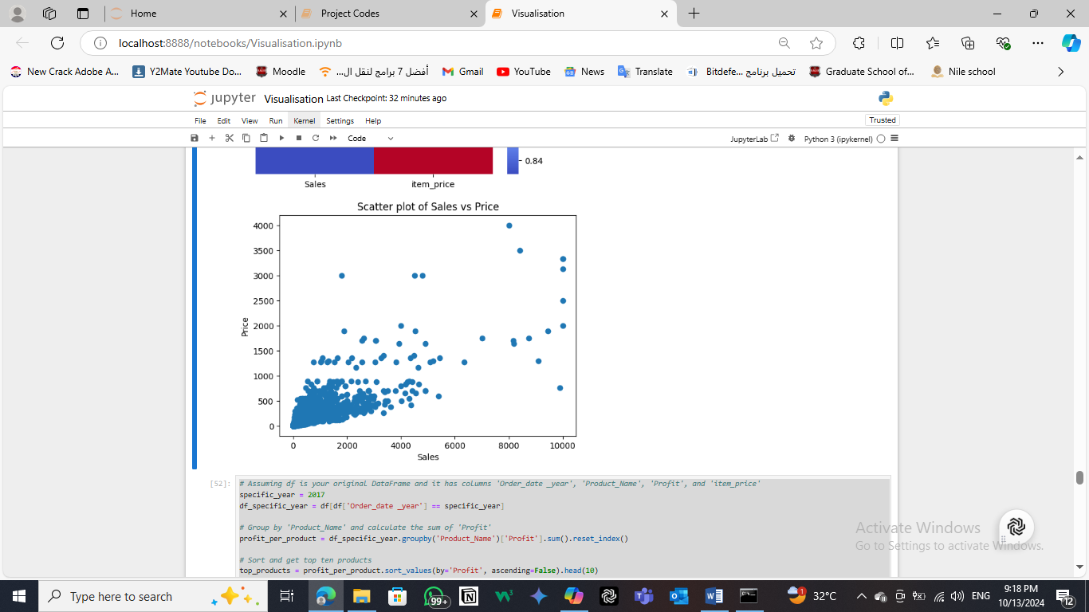
Phase 2 Analysis Questions Phase
B. Analysis stage
5.1 Correlations between Sales & Profit to Price
# Calculate the correlation
correlation = df[['Sales', 'item_price']].corr()
correlation
 | Sales | item_price
Sales | 1.000000 | 0.829405
item_price | 0.829405 | 1.000000

Slide 46
Phase 2 Analysis Questions Phase
B. Analysis stage
5.1 Correlations between Sales & Profit to Price
Sales and Item Price (0.829405): Strong positive correlation. This suggests that as the item price increases, sales tend to increase as well. This could mean that higher-priced items are selling well, or that there is a general trend where pricier items contribute more to sales.
In short, your data indicates a strong relationship between item prices and sales, implying that higher item prices are associated with higher sales.

Slide 47
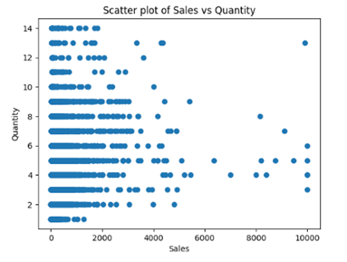
Phase 2 Analysis Questions Phase
B. Analysis stage
5.2 Correlations between Sales & Quantity
# Calculate the correlation
correlation = df[['Sales', 'Quantity']].corr()
correlation
 | Sales | Quantity
Sales | 1.000000 | 0.220121
Quantity | 0.220121 | 1.000000

Slide 48
Phase 2 Analysis Questions Phase
B. Analysis stage
5.2 Correlations between Sales to Quantity
Sales and Quantity (0.220121): A weak positive correlation. This suggests that as the quantity sold increases, sales tend to increase slightly, but the relationship is not very strong. So, in essence, while there is a slight positive relationship between sales and quantity, it’s not particularly strong.

Slide 49
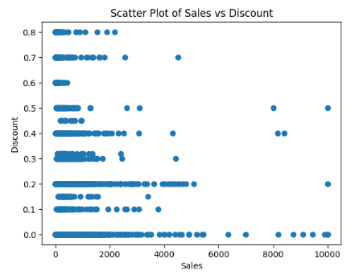
Phase 2 Analysis Questions Phase
B. Analysis stage
5.3 Correlations between Sales & Discount
correlation = df[['Sales', 'Discount']].corr()
print(correlation)
 | Sales | Discount
Sales | 1.000000 | -0.033509
Discount | -0.033509 | 1.000000

Slide 50
Phase 2 Analysis Questions Phase
B. Analysis stage
5.3 Correlations between Sales to Quantity
Sales and Discount (-0.033509): Very weak negative correlation. This suggests that there’s almost no relationship between sales and discounts. In other words, changes in discount levels don’t have a strong impact on sales in your data.
In short, your data indicates that there’s no meaningful relationship between discounts and sales in your dataset

Slide 51
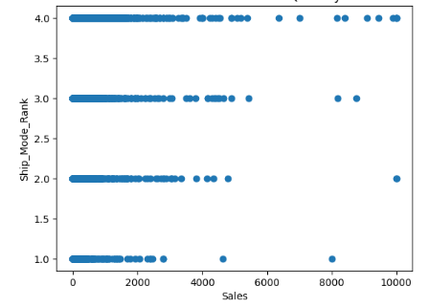
Phase 2 Analysis Questions Phase
B. Analysis stage
5.4 Correlations between Sales &
Ship Mode Rank
# Calculate the correlation
correlation = df[['Sales', 'Ship_Mode_Rank']].corr()
correlation
 | Sales | Ship_Mode_Rank
Sales | 1.000000 | -0.004893
Ship_Mode_Rank | -0.004893 | 1.000000

Slide 52
Phase 2 Analysis Questions Phase
B. Analysis stage
5.4 Correlations between Sales to Ship Mode Rank
Sales and Ship Mode Rank (-0.004893): Extremely weak negative correlation. This suggests that changes in the rank of shipping mode have almost no impact on sales. In essence, your data shows that the shipping mode's rank doesn't significantly affect sales.

Slide 53
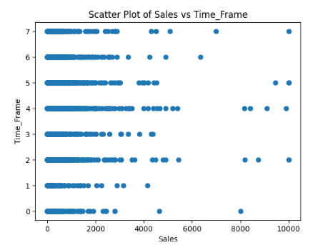
Phase 2 Analysis Questions Phase
B. Analysis stage
5.5Correlations between Sales & Time Frame
# Calculate the correlation
correlation = df[['Sales', 'Time_Frame']].corr()
print(correlation)
 | Sales | Time Frame
Sales | 1.000000 | -0.010859
Time Frame | -0.010859 | 1.000000

Slide 54
Phase 2 Analysis Questions Phase
B. Analysis stage
5.5 Correlations between Sales to Time Frame
Sales and Time Frame (-0.010859): Extremely weak negative correlation. This suggests that the time frame has virtually no impact on sales. In essence, your data shows that the time frame doesn't significantly affect sales..

Slide 55
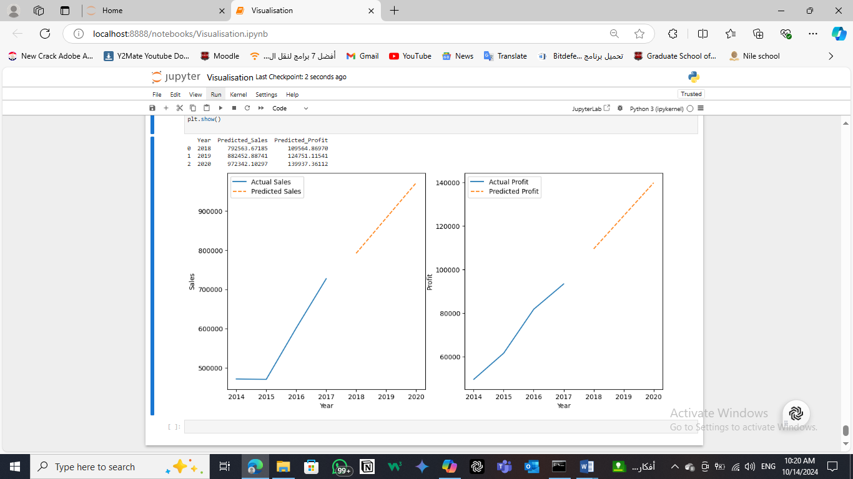
Phase 3 Forecasting Questions Phase
A. What are the forecasts for both Sales and Profit in the coming three years?

Slide 56
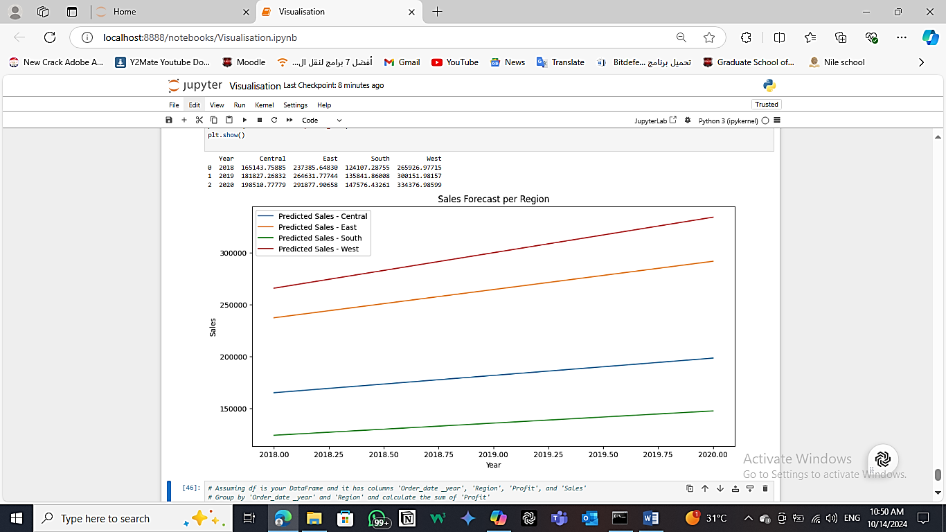
Phase 3 Forecasting Questions Phase
B. What are the forecast for sales & Profit for Regions in the Coming three years?

Slide 57
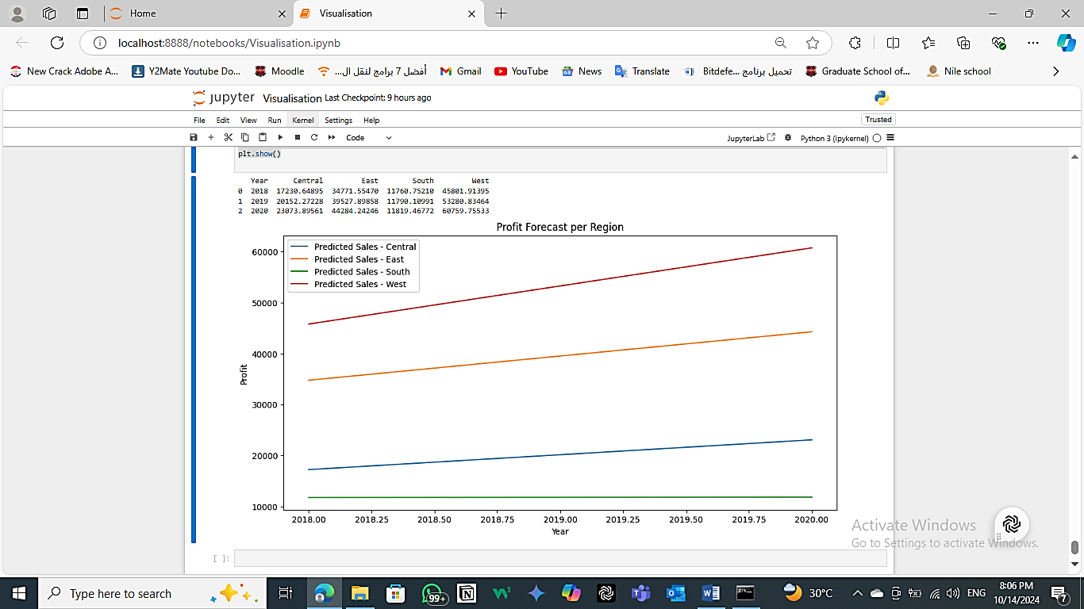
Phase 3 Forecasting Questions Phase
B. What are the forecast for sales & Profit for Regions in the Coming three years?

Slide 58
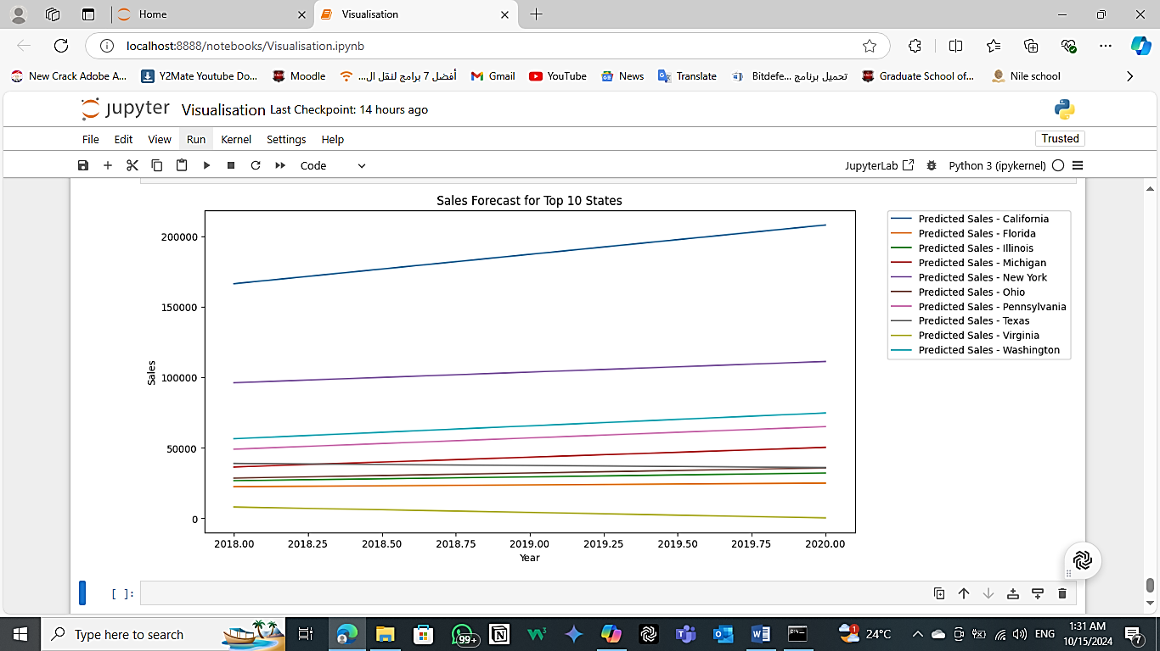
Phase 3 Forecasting Questions Phase
C. What are the forecast for sales & Profit for States in the Coming three years?

Slide 59
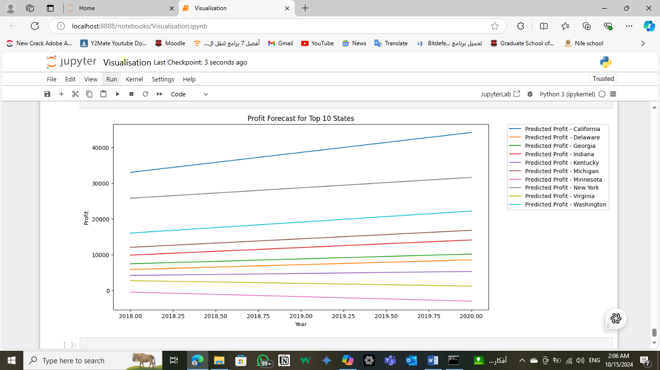
Phase 3 Forecasting Questions Phase
C. What are the forecast for sales & Profit for States in the Coming three years?

Slide 60
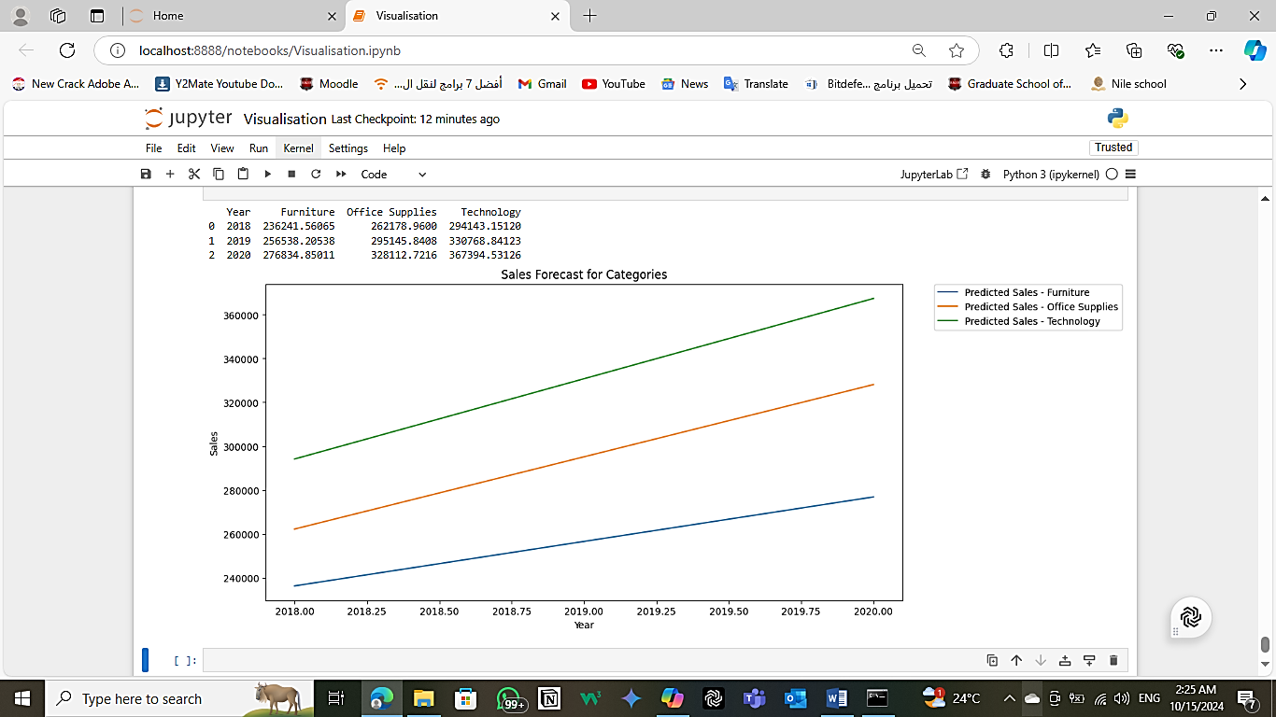
Phase 3 Forecasting Questions Phase
D. What are the forecast for sales for Categories in the Coming three years?

Slide 61
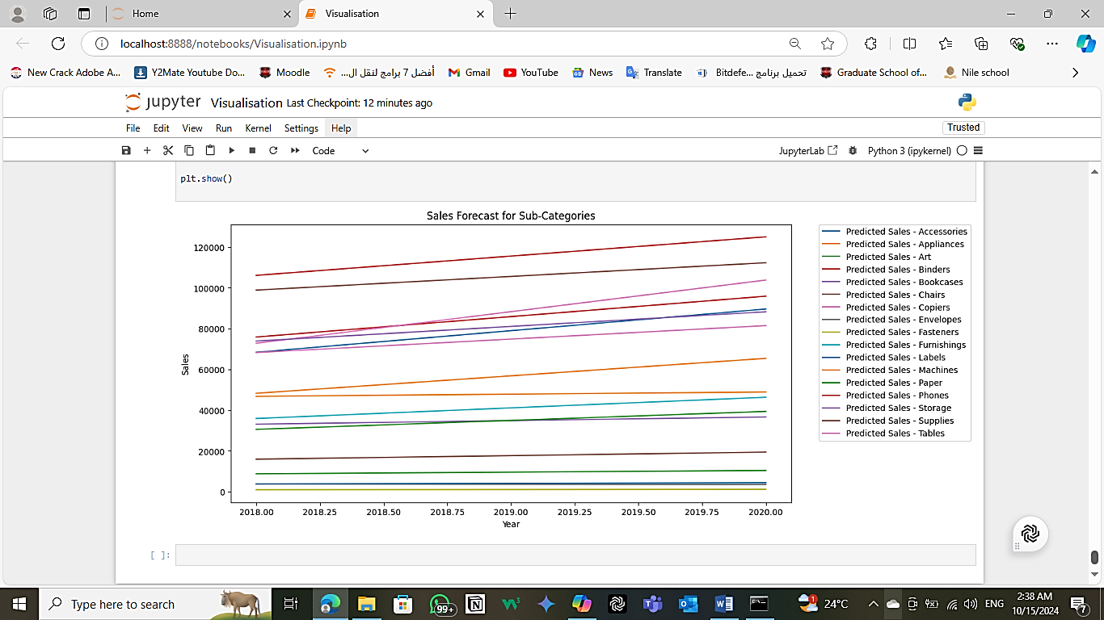
Phase 3 Forecasting Questions Phase
E. What are the forecast for sales for Sub_Categories in the Coming three years?

Slide 62
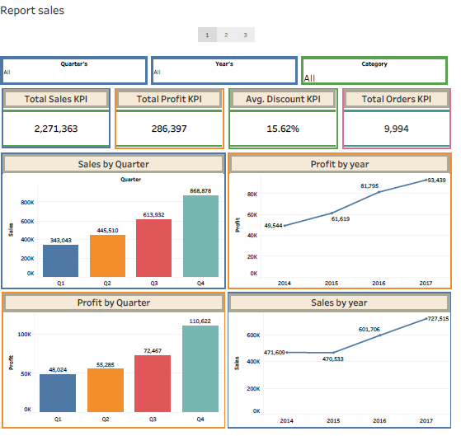
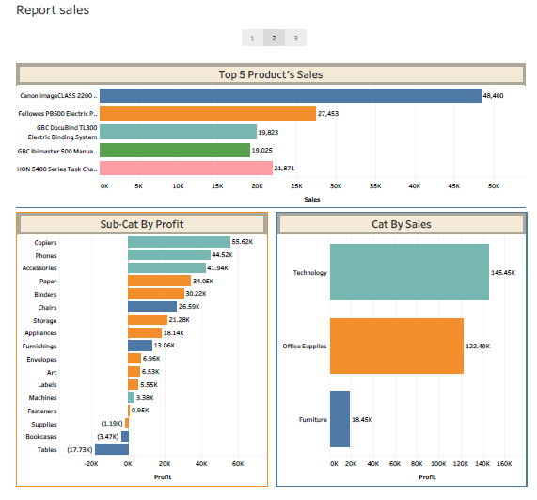
Phase 4: Data Visualization

Slide 63
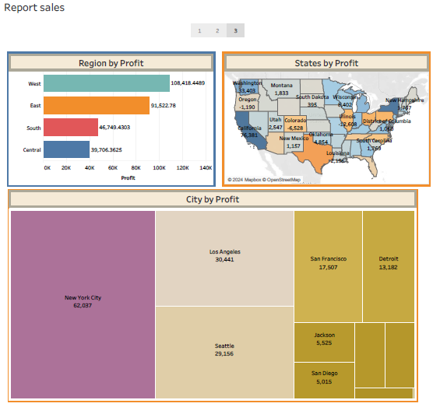
Phase 4: Data Visualization

Slide 64
Thank You

